Slide 1
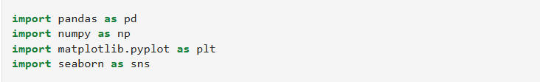
Analysis of Kid’s Screen Time
Week 1 Report – Project Initialization and Data Setup
Purpose of the Week 1:
The primary objective for Week 1 was to set up the project environment, import the dataset, and examine its structure to assess data quality and identify key patterns. This phase serves as the groundwork for upcoming stages — including preprocessing, feature engineering, and visualization — focused on analyzing children’s screen time habits to provide meaningful insights for parents, teachers, and policymakers.
2. IMPLEMENTATION
Step 1: Importing Essential Libraries
Python libraries like Pandas, NumPy, Matplotlib, and Seaborn were imported to support data manipulation, analysis, and visualization tasks. These libraries form the backbone of the project, enabling efficient data processing and insightful graphical representation.

Slide 2
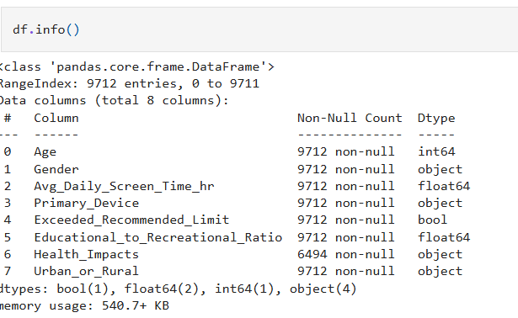
Step 2: Dataset Loading Loaded the 'Indian Kids Screentime 2025' dataset and verified successful import with 9,712 rows and 8 columns.
Step 3: Data Structure and Summary Analysis
To gain an initial understanding of the dataset, the functions df.info() and df.describe() were used. The df.info() method provided a detailed overview of the dataset’s structure, including the number of entries, column names, and their respective data types. Meanwhile, df.describe() generated summary statistics such as mean, median, standard deviation, minimum, and maximum values for numerical features.

Slide 3
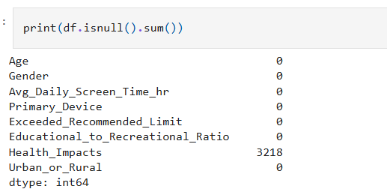
Step 4 : Missing Value Analysis
The command df.isnull().sum() was used to check for missing values in each column. Most columns had no missing data, ensuring consistency. However, the ‘Health_Impacts’ column showed 3218 missing values, which need to be addressed during preprocessing for accurate analysis.
Step 5 : Handling Missing Data
To manage missing entries in the ‘Health_Impacts’ column, the fillna('Unknown') method was applied. This replaced all null values with ‘Unknown’, ensuring data consistency and preventing errors during analysis.

Slide 4
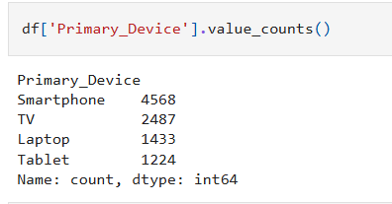
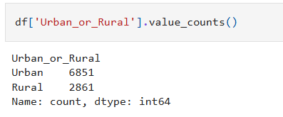
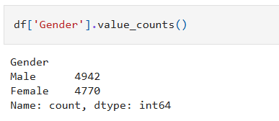
Step 6 : Demographic and Device Distribution Analysis
The dataset was analyzed to understand the distribution of key demographic and usage factors using the value_counts() function.
Urban vs Rural: Out of all participants, 6,851 were from urban areas and 2,861 from rural areas, showing higher representation from urban regions.
Primary Device Usage: The most commonly used device was the Smartphone (4,568), followed by TV (2,487), Laptop (1,433), and Tablet (1,224)
Gender Distribution: The dataset contained 4,942 males and 4,770 females, indicating a nearly balanced gender ratio

Slide 5
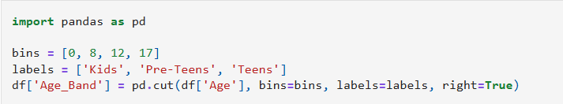
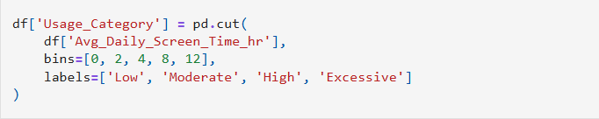
Step 7: Creating Age Groups
An ‘Age_Band’ column was created using pd.cut() to group children as Kids (0–8), Pre-Teens (9–12), and Teens (13–17). This helps compare screen time across different age groups.
Step 8: Screen Time Classification
Using pd.cut(), children were grouped into four categories based on daily screen time — Low (0–2 hrs), Moderate (2–4 hrs), High (4–8 hrs), and Excessive (8–12 hrs) — to analyze variations in screen usage.

Slide 6
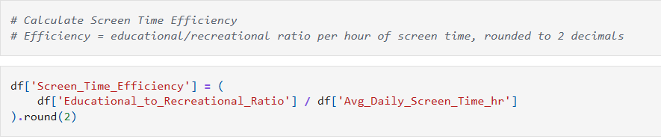
Step 9: Calculating Screen Time Efficiency
A new column ‘Screen_Time_Efficiency’ was created by dividing the Educational-to-Recreational Ratio by average daily screen time and rounding the result to two decimals. This metric helps measure how effectively kids use their screen time for educational purposes.

Slide 7
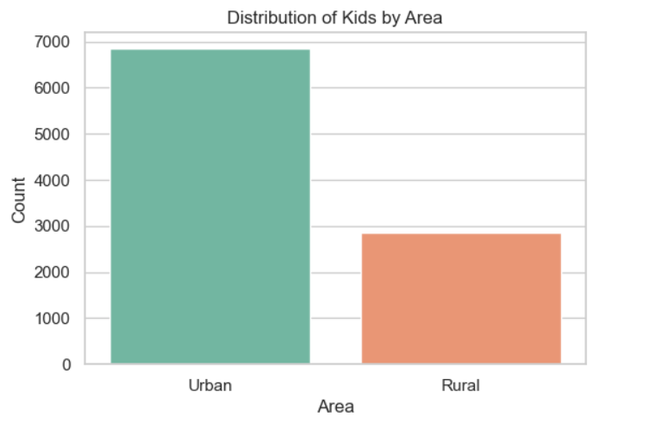
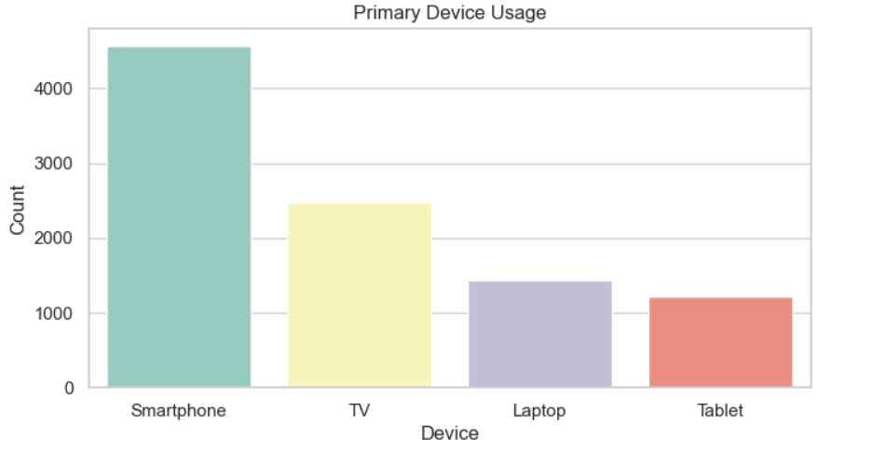
Step 10 : Data Visualization and Insights
Various visualizations were created using Seaborn to explore the dataset.
Urban vs Rural Distribution: Shows higher participation from urban kids.
Primary Device Usage: Smartphones were the most used devices.

Slide 8
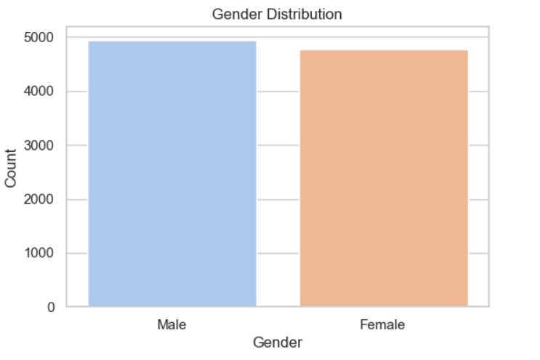
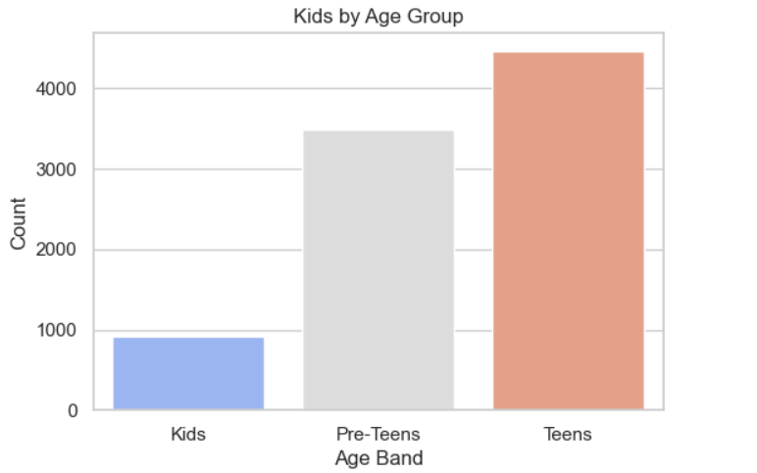
Gender Distribution: Nearly equal count of males and females.
Age Band Distribution: Displays the count of Kids, Pre-Teens, and Teens.

Slide 9
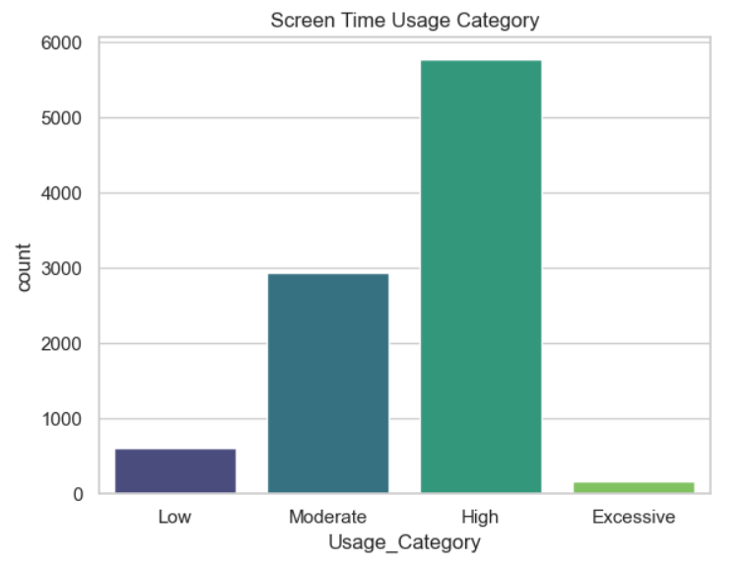
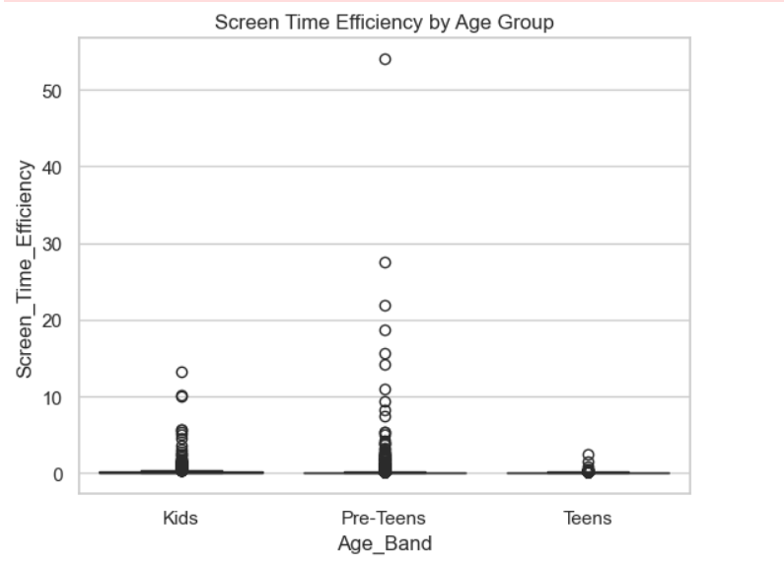
Screen Time Categories: Highlights how screen usage varies from Low to Excessive.
Screen Time Efficiency: Boxplot shows how efficiently each age group uses screen time for educational purposes.

Slide 10
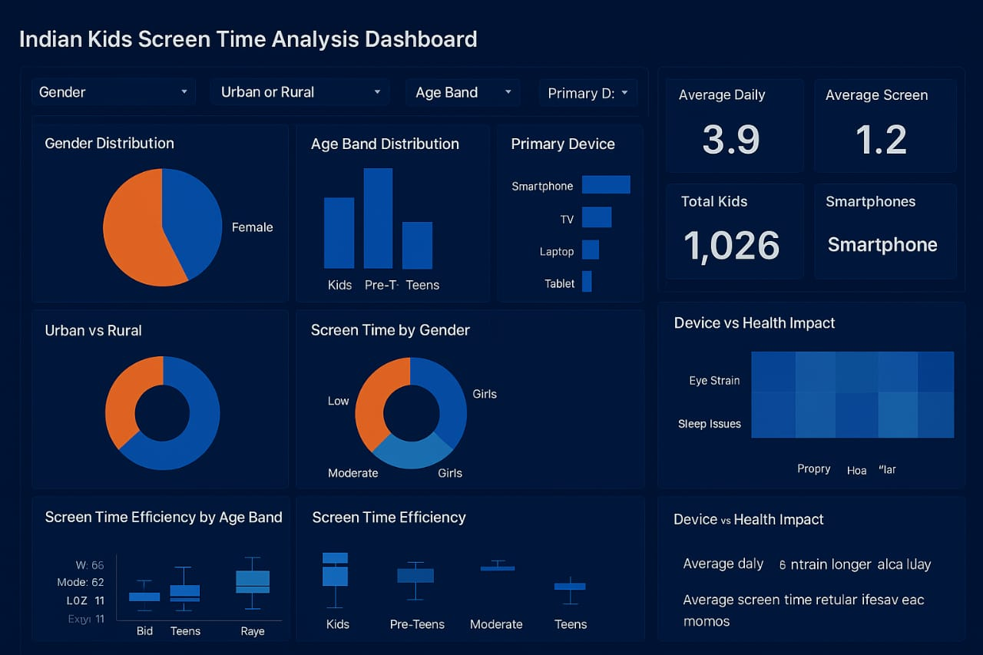
Next Focus:
Main QuestionMain Question: Analyze kids’ screen time patterns across demographics, devices, and efficiency to gain actionable insights.Looking for some hidden patterns.
Dashboard: Created the Tableau dashboard using Excalidra and enhanced visuals with ChatGPT for clear insights.This is not the final dashboard outlook I’m going make changes accordingly to show the insights and make the dashboard looks better.
Report By – puli bharat

